Slide 2
OBJECTIVES
PRINCIPLE
God is in control
PRACTICAL
How do we respond to the world in light of this fact?

Slide 3
DANIEL: THE AUTHOR
Daniel = “God is my Judge”
Significance?

Slide 4
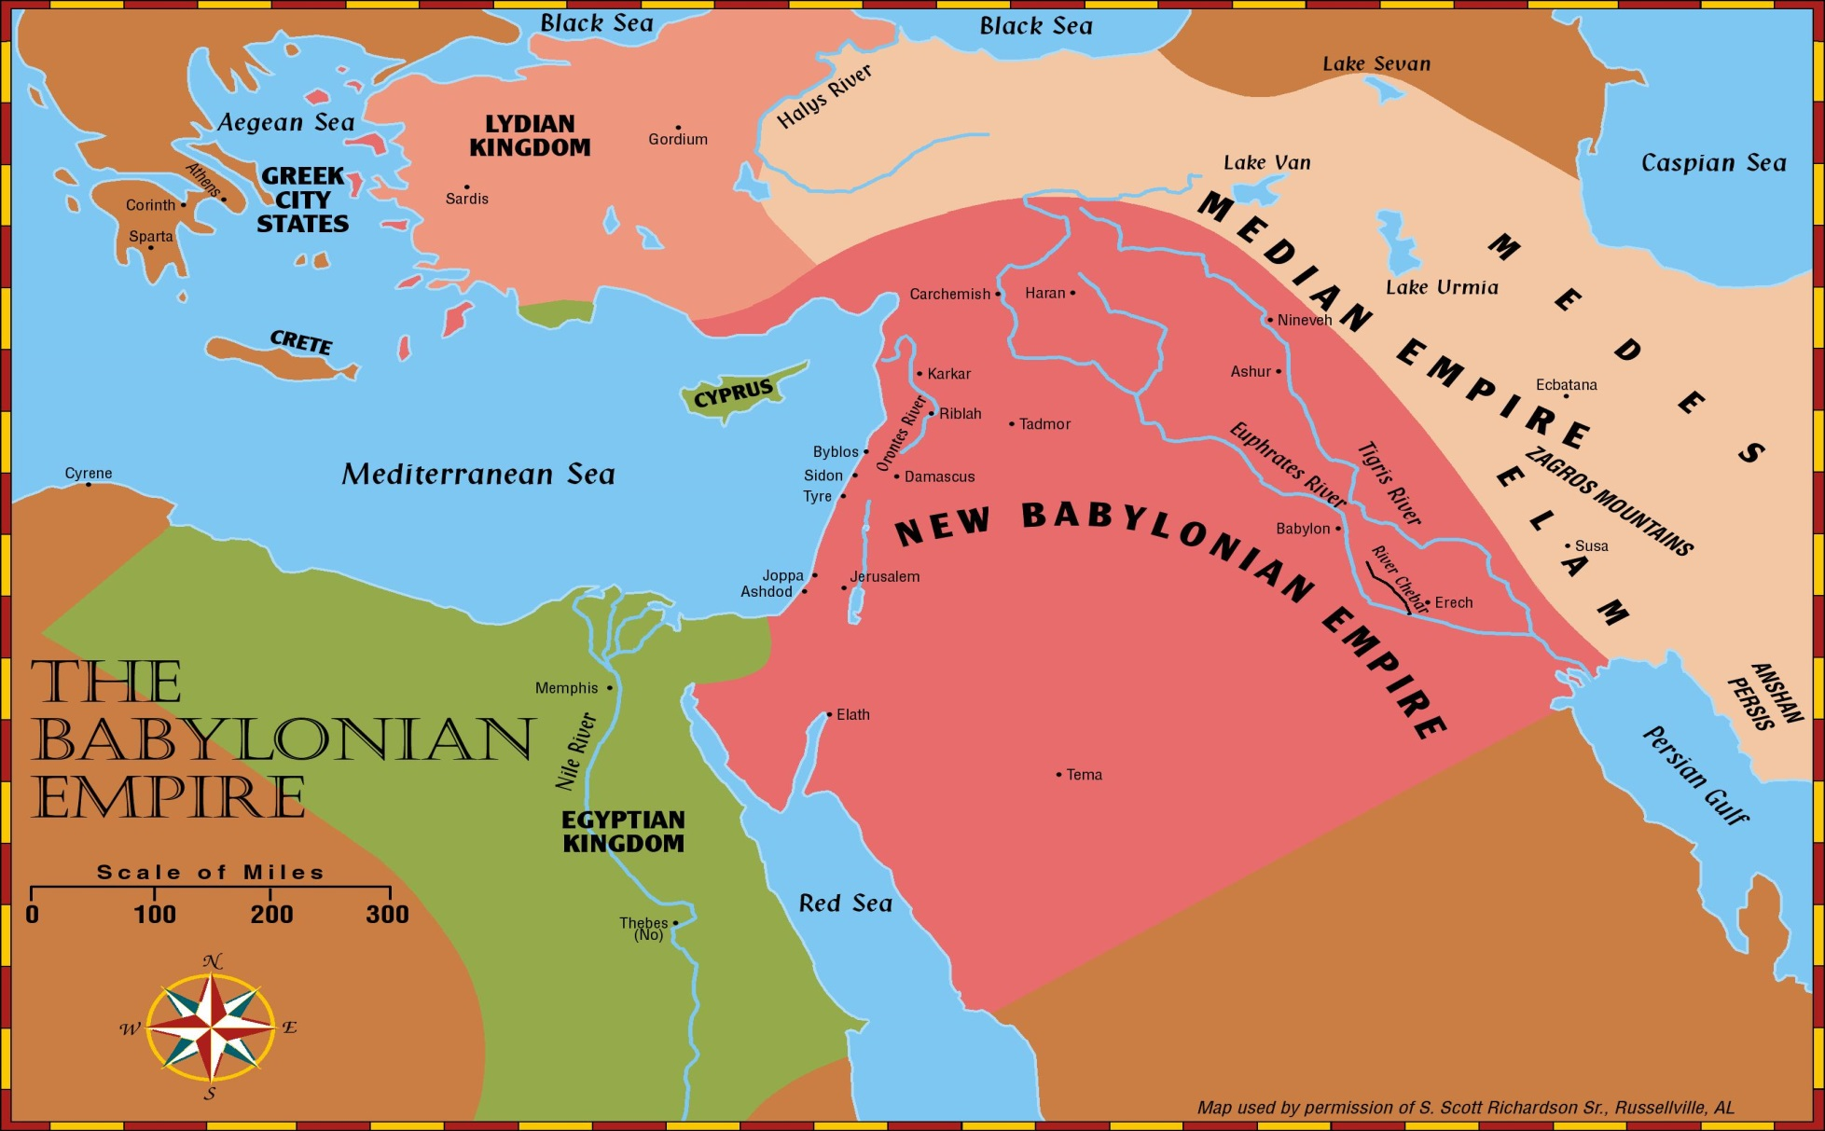
DANIEL: THE AUTHOR
Which two great world empires did Daniel witness in his lifetime?
Babylonian Empire
Medo-Persian Empire
Of which two great Old Testament prophets was he a contemporary?
Ezekiel and Jeremiah

Slide 5
DANIEL: THE AUTHOR
To what kind of family was Daniel born and what was his place in society? (See Dan 1:3-4; Isa 39:7)
“Of the royal family” and “of the nobles”
He was among the first deportation from Jerusalem to Babylon
Remember Ezekiel 17:13-14? “[the king of Babylon] took away the mighty of the land that the kingdom might be in subjection, not exalting itself”

Slide 6
DANIEL: THE AUTHOR
How many years of Daniel’s life does the book record?
70 years! (605-535 BC)
A “youth in whom there was no defect” in ch 1
But around 80 years old when thrown into the lion’s den!

Slide 7
DATES AND SIGNIFICANT MOMENTS
722 BC
586 BC
Temple/City Destroyed
Northern Kingdom:
ISRAEL
597 BC
Ezekiel
605 BC
Daniel
Saul
David
Solomon
Southern Kingdom:
JUDAH
539 BC
Babylon Falls
931 BC

Slide 8
DATES AND SIGNIFICANT MOMENTS
400 Years of
“SILENCE”
420 BC - ~25 AD
We read of much of what is to occur during this time period in the latter half of Daniel

Slide 9
IMPORTANT CHARACTERS
What are the names of the four Hebrew men who appear in this book and what are their Chaldean names / meaning?
Daniel^{H}
“God is my Judge”
Belteshazzar^{B}
“May Balak protect”
Shadrach^{B}
“Command of Aku”
Hananiah^{H}
“The Lord is gracious”
Meshach^{B}
“Who is what Aku is”
Mishael^{H}
“Who is what God is”
Abenego^{B}
“Servant of Nebo”
Azariah^{H}
“The Lord has helped”

Slide 10
IMPORTANT CHARACTERS
Who are the four kings mentioned in the book and what empires do they have dominion over?
Two Kings of Babylon
Ch 1-3 Nebuchadnezzar “Nebo, protect the crown”
Ch 5,7,8 Belshazzar “Bel protect the king”
Two Kings of Media – Persia
Ch 1,6,10 Cyrus the Persian “Throne”
Ch 5-6,9,11 Darius the Mede “Preserver”

Slide 11
PATTERNS AND STRUCTURE
What are the two distinct halves of the book, in the most basic sense?
Chapters 1-6: Stories about Daniel (Narrative)
Chapters 7-12: Visions of Daniel (Prophecy)
But it’s a little more complex / interesting than that…

Slide 12
PATTERNS AND STRUCTURE
What three major miracles occur in the narrative and / or martyr story sections?
Chapter 3
Chapter 5
Chapter 6
But why these three as it relates to structure or theme?
A message from God to each persecuting ruler?
The same story (God humbles) with three different results
SAVED FROM FIERY FURNACE
HAND WRITING ON WALL
SAVED FROM LION’S DEN

Slide 13
PATTERNS AND STRUCTURE
Note the inverted parallelism of the middle Aramaic section (ch 2-7)
a. Chapter 2
b. Chapter 3
c. Chapter 4
d. Chapter 5
e. Chapter 6
f. Chapter 7
VISION OF FOUR KINGDOMS
MARTYR STORY (THREE FRIENDS)
NEBUCHADNEZZAR’S PRIDE
BELSHAZZARS’S PRIDE
MARTYR STORY (LION’S DEN)
VISION OF FOUR KINGDOMS

Slide 14
THEME
What is the major theme of Daniel according to Dan 2:21; 4:17,25,32,34-35; 5:21?
The Most High is ruler over the realm of mankind and bestows [authority] on whom He wishes

Slide 15
THEME
God REVEALS (ch 2/5)
God RESCUES (ch 3/6)
God RULES (ch 4/7)

Slide 16
USE IN THE NT?
DANIEL IN MATTHEW?
The parable of the Sower and Tares relies on “Son of Man” and kingdom imagery from Daniel 7
The punishment for those who commit lawlessness is being “cast into the furnace of fire” (Daniel 3:6)
The reward for the faithful: “the righteous will shine like the sun” (Dan 12:2-3)
The parable of the Mustard Seed? Daniel 4

Slide 17
USE IN THE NT?
DANIEL IN MATTHEW?
Jesus foretelling of Jerusalem’s destruction? Daniel 9
Jesus’ response before the high priest (“blasphemy”)? Daniel 7
The great commission in Matt 28? Daniel 12
And that’s just Matthew!
John records Jesus quoting Daniel 12 almost directly in His discussion on resurrection (John 4:25-30)

Slide 18
SPIRITUAL WARFARE
Tracing the Battles throughout Daniel
Who wins?

